Slide 1
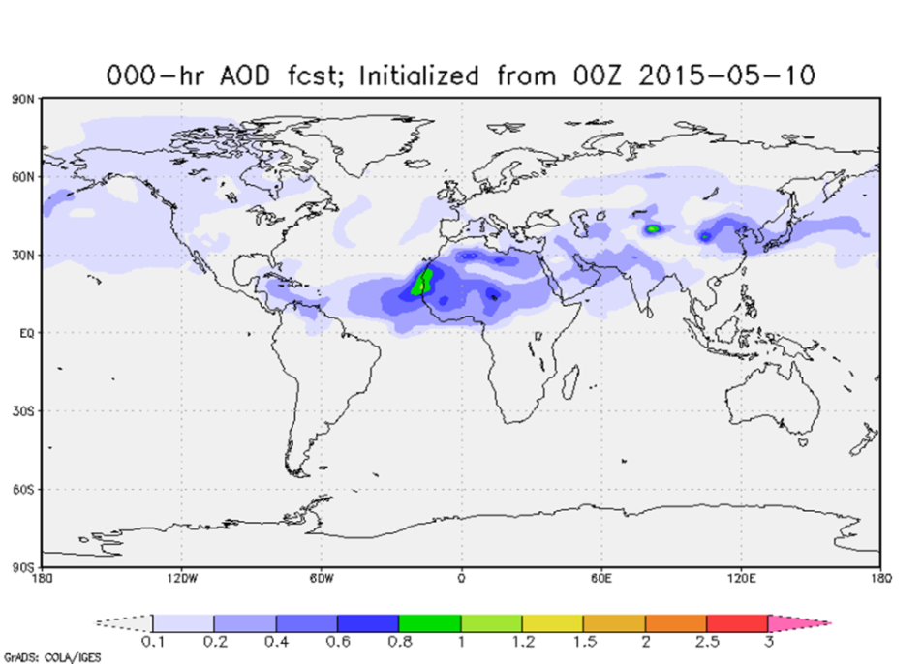
Aerosol and Atmospheric Composition
Team Overview
NGGPS Program
Meeting
Ivanka Stajner
Yu-Tai Hou
August 4, 2016

Slide 2
NGGPS Prediction
Model Components
Atmospheric Components
Aerosols/
Atm Composition
(GOCART/MAM)
Whole
Atm Model
(WAM)
Atm Dycore
(TBD)
Atm Physics
(CCPP)
NEMS/ESMF
Land Surface
(NOAH)
Ocean
(HYCOM)
(MOM)
Wave
(WW3)
(SWAN)
Sea Ice
(CICE/KISS)
NGGPS implementation plan development includes an aerosol and atmospheric composition team
Development of dust/aerosol capabilities is underway by universities and federal labs
Notes:
NGGPS prediction model will consist of fully coupled components representing different parts of the Earth system. All components will be based on community codes. Atmospheric aerosol component improvement is underway.

Slide 3
Aerosol and
Atmospheric Composition
Aerosols, e.g. dust, smoke, volcanic ash, sea salt, sulfate, black carbon, organic carbon and anthropogenic aerosols
Gaseous composition, e.g. ozone, NO_{X,} methane, CO₂
Aerosol and atmospheric composition effects on radiation, clouds and assimilation of satellite radiances

Slide 4
Aerosol and Atmospheric
Composition Team Plan Priorities
Improve aerosol forecast capability, impacts of aerosol on radiation, microphysical processes and assimilation of observations
Improve ozone forecast capability, impacts of ozone on radiation and assimilation of observations
Integrate with the overall physics package

Slide 5
Aerosol and Atmospheric Composition Model Development Team
Ivanka Stajner, NWS/OSTI, co-lead
Yu-Tai Hou, NWS/EMC, co-lead
Georg Grell, ESRL
Arlindo da Silva, NASA/GMAO
Edward Hyer, NRL
Kenneth Pickering, NASA
Brad Pierce, NESDIS
Sim Larkin, USFS
Paul Ginoux, GFDL
Jeff McQueen, NWS/EMC
Jun Wang, EMC
Craig Long, NWS/CPC
Larry Horowitz, GFDL
Gregory Frost, ESRL
Stuart McKeen, ESRL
Ariel Stein, ARL
In coordination with physics and data assimilation teams:
  Shrinivas Moorthi, NWS/EMC
  Jim Doyle, NRL
  Bill Kuo, NCAR
  John Derber, NWS/EMC
  Tom Auligné, JCSDA

Slide 6
NEMS GFS
Aerosol Component (NGAC)
NGAC is a global in-line aerosol forecast system
Goddard Chemistry Aerosol Radiation and Transport (GOCART) model is the aerosol component model of NGAC
  Funded mainly by NASA Earth Science programs
Implementation into NEMS GFS at NCEP was funded by NOAA-NASA-DOD JCSDA and NASA Applied Sciences Program
Produces 120-hour global dust forecasts

Slide 7

Operational NWS global
predictions of dust AOD
NEMS GFS Aerosol Component (NGAC)
Animation from http://www.emc.ncep.noaa.gov/gmb/NGAC/html/realtime.ngac.html
Notes:
Operational NWS global model prediction of dust aerosol optical depth (AOD) initialized on May 10, 2015 at 0z.
Animation from http://www.emc.ncep.noaa.gov/gmb/NGAC/html/realtime.ngac.html
GOCART aerosol model with in the Global Forecast System (GFS)

Slide 8
NEMS GFS Aerosol Component
Current State
Near-real-time operational system
The first global in-line aerosol forecast system at NCEP
AGCM: NCEP’s NEMS GFS
Aerosol: GSFC’s GOCART
120-hr dust-only forecast once per day (00Z), output every 3-hr
ICs: Aerosols from previous day forecast and meteorology from operational GDAS
Implemented into NCEP Production Suite in Sept 2012
Ongoing Activities and Future Plans
Full package implementation (dust, sea salt, sulfate, and carbonaceous aerosols) FY16
Aerosol analysis using VIIRS AOD FY18 (tentative)
Provide lateral boundary condition for downstream regional CMAQ model FY16
Provide aerosol information for potential downstream users (e.g., NESDIS’s SST retrievals, CPC-EPA UV index forecasts)

Slide 9
GFS Ozone Model
Assimilation of 22 retrieved layers from NOAA-19 Solar Backscatter Ultraviolet Instrument (SBUV/2) version 8 retrievals and total ozone columns from the Ozone Monitoring Instrument (OMI)
Chem2D parameterization
  Chemical production and loss
  Operational implementation uses only two of the four terms
  Loss of ~1% global total column ozone within first 5 days of forecasts
  An additional 2%-3% loss by 10-15 days
  J. McCormack, T. Hogan, NRL; M. Iredell, S. Moorthi and C. Long, NCEP
No heterogeneous chemistry (i.e. ozone hole) parametrization
Ongoing project funded by CPO to incorporate remaining two terms to better constrain total ozone budget

Slide 10
Aerosol and Atmospheric
Composition Prediction Gaps
GFS microphysical and cloud parameterization schemes currently do not use predicted aerosols
Addition of aerosol effects has a potential to improve global precipitation distribution and cloud properties
Inclusion of anthropogenic aerosols, nitrates and secondary organic aerosols
Improved biomass burning emissions
Use of predicted aerosols in radiation and assimilation of satellite radiances
Inclusion of gas phase tropospheric chemistry

Slide 11
NGGPS Aerosol and Atm Composition
Development in Progress
Paul Ginoux (NOAA GFDL)
  Implementation and Testing of Regional and Global Dust Forecasting
Sarah Lu (SUNY Albany)
  Investigation of Aerosol Effects on Weather Forecast using NCEP Global Forecast System – radiative effects
  Improving Cloud Microphysics and Their Interactions with Aerosols in the NCEP Global Models (co-funded with CPO)
Zhanqing Li (Univ. of MD)
  Evaluating the Impact of Cloud-Aerosol-Precipitation Interaction (CAPI) Schemes on Rainfall Forecast in the NGGPS
Georg Grell (NOAA/ESRL/GSD)
  Using Advanced Photochemical and Aerosol Modules to Verify the Applicability of GOCART Aerosol Modules within Global Weather Prediction Models
  Developing a Unified Online Air Quality Forecasting System Based on CMAQ and NGGPS (co-funded with USWRP) - New

Slide 12
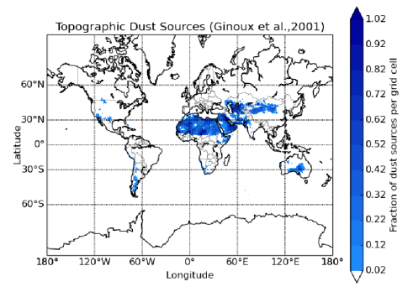
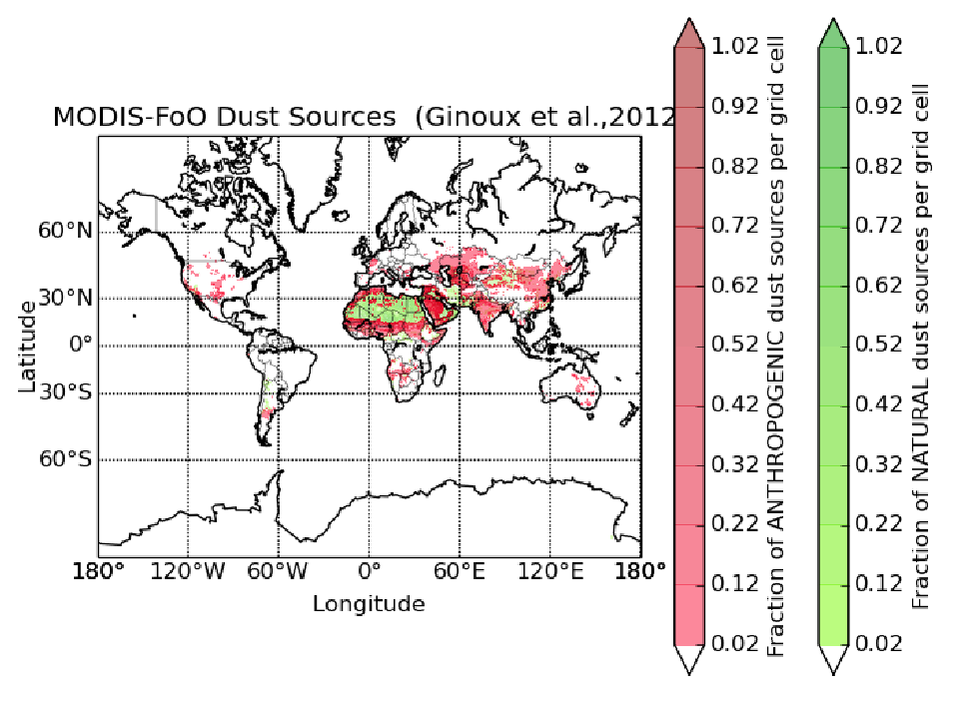
Implementation and testing of regional and global dust forecasting
Paul Ginoux, NOAA GFDL
Develop and evaluate high resolution satellite based dust source inventory (Baddock et al., 2015)
Derive velocity threshold of wind erosion, key parameter of dust emission (Ginoux and Deroubaix, 2016)
Implement and test sources and emission schemes with NMMB-BSC global and regional simulations by comparing with observations (Perez et al., in preparation)
GOCART dust sources
Only natural
MODIS based dust sources
natural & agricultural
NMMB-BSC has been imported and compiled on Gaea
Emission and removal processes have been improved
Simulations performed on Gaea using 248 CPU:
  Testing with global 1x1 degree for 2012
  Case study of Syrian haboob with 2x2 km Sept 2015
Post processing done on GFDL cluster using python

Slide 13
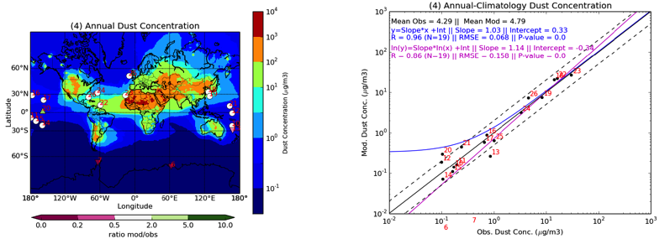
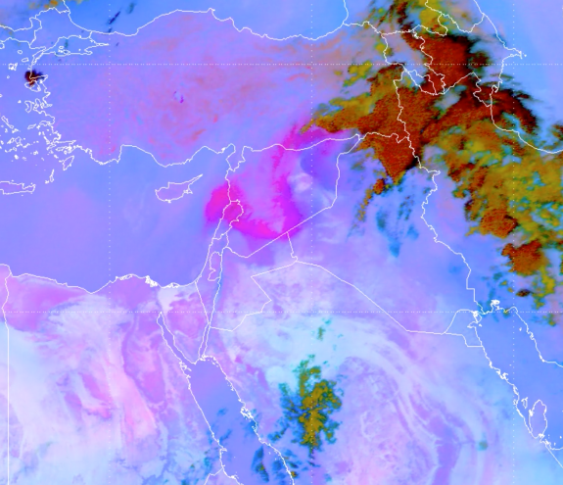
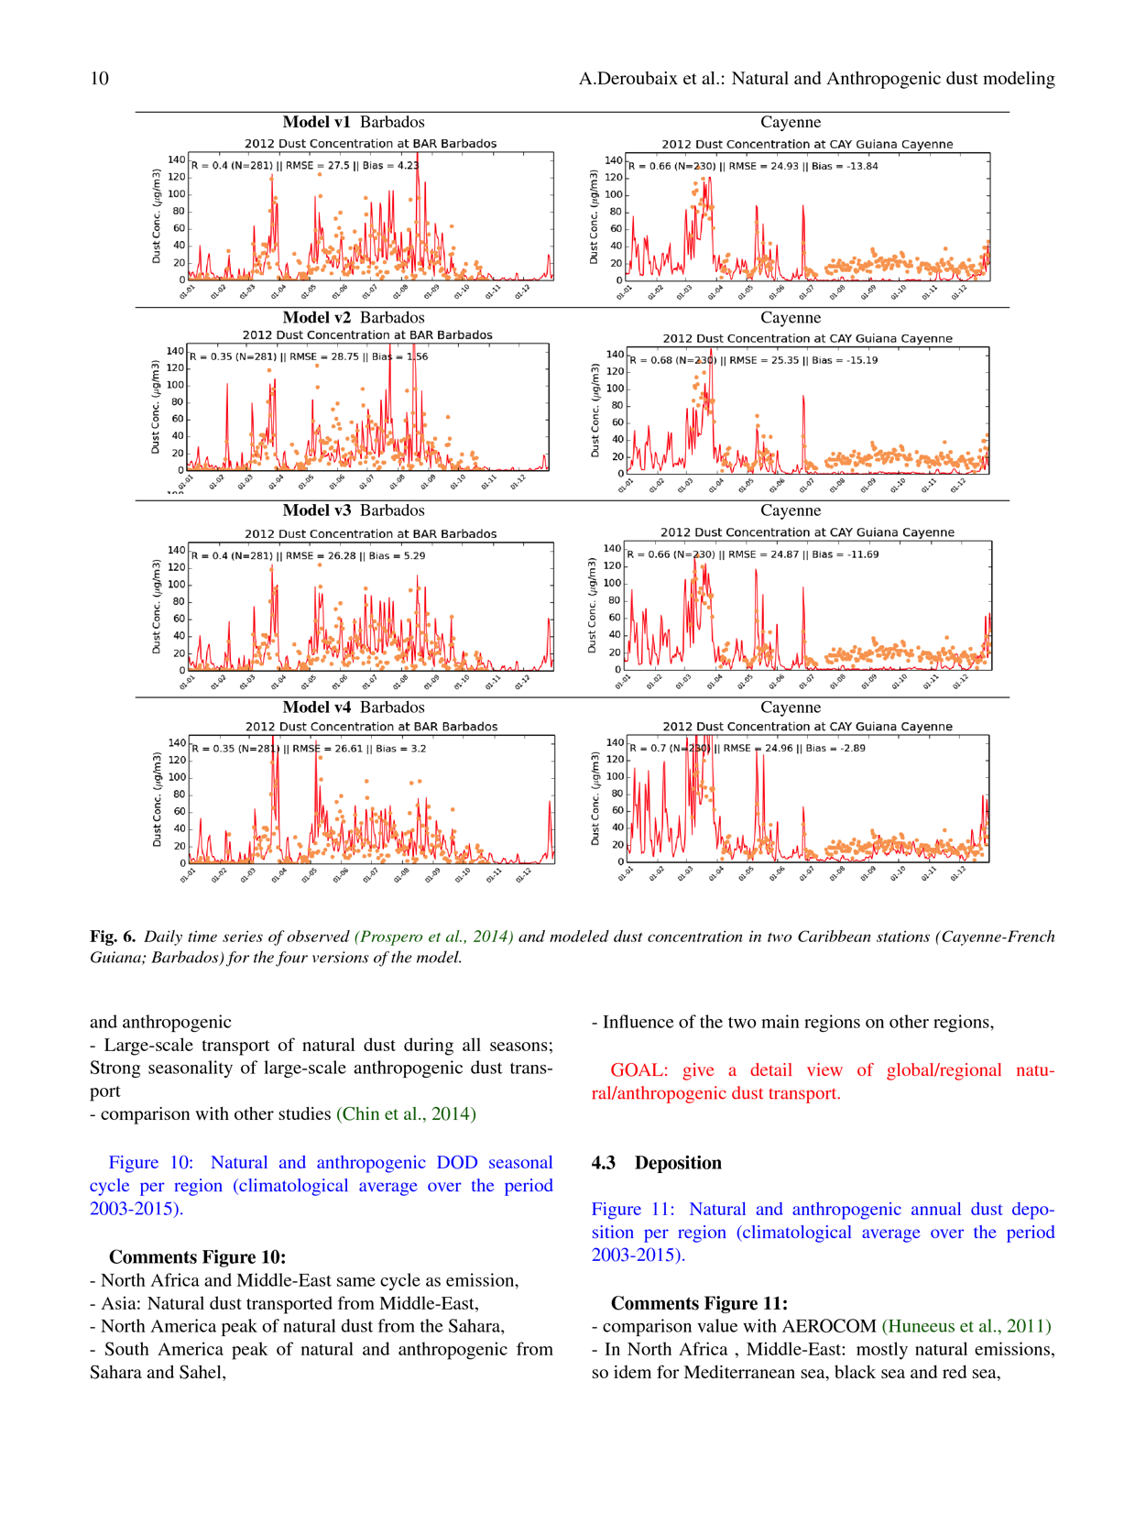
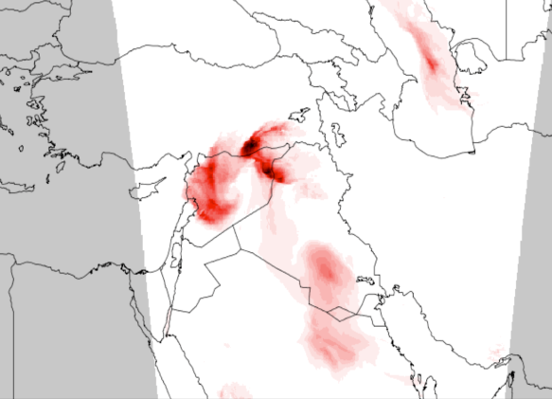
Implementation and testing of regional and global dust forecasting, cont. (1)
Paul Ginoux, NOAA GFDL
Annual (2012) mean surface dust concentration comparison with University of Miami data
Daily surface dust concentration for 2012 at Barbados
Syrian haboob(s) 09/2015
MSG-SEVIRI
NMMB-BSC 2x2 km

Slide 14
Implementation and testing of regional and global dust forecasting, cont. (2)
Paul Ginoux, NOAA GFDL
Deliverables:
  Global 0.1 deg resolution dust source inventory (MODIS based)
  Dust model fortran code for NMMB
  Post-processing python code for aerosol model evaluation
  Papers: Baddock et al. (Geophys. Res. Lett.,2015), Ginoux and Deroubaix (submitted to Springer Verlag, 2016), Perez et al. (in preparation).
Future:
Implement and evaluate NMMB dust scheme in NGGPS
Implement other aerosols in NGGPS
Use of new satellite products for dust detection and analysis

Slide 15
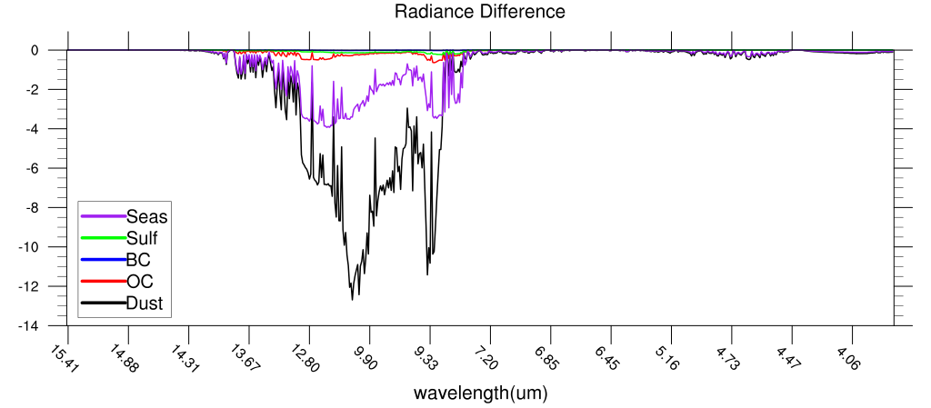
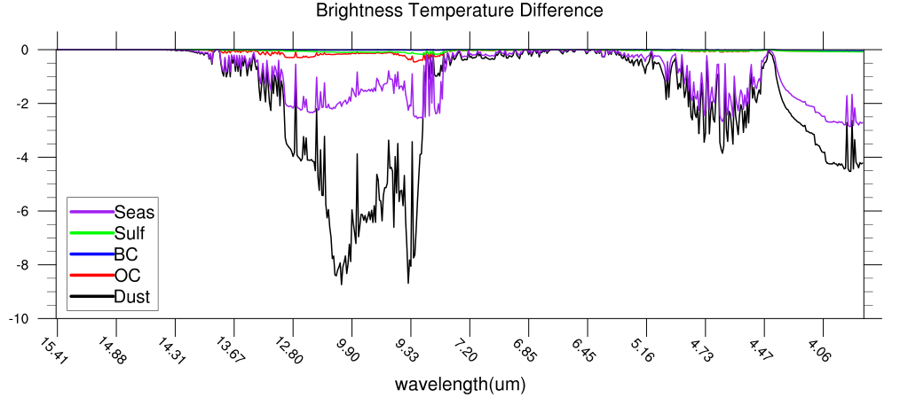
Investigation of aerosol effects on weather forecast using NCEP Global Forecast System
Sarah Lu (SUNY-Albany), Quanhua Liu (NESDIS/STAR), Robert Grumbine (NCEP)
Overarching goal: Investigating how much complexity is needed to accurately represent the aerosol processes and effectively account for aerosol effects
Proposed approach:
  Aerosol fields from low-resolution NGAC run are fed to high-resolution GDAS, allowing aerosol radiative effects in GSM, physical retrievals in RTG_SST, and aerosol attenuation in hybrid EnKF-GSI to be determined from NGAC forecasts.
Project deliverables: Flexible aerosol configuration in GDAS parallel scripts
Aligned with NGGPS efforts to advance physical parameterization and data assimilation
Transition to operations implementation: All code development will be committed to NCEP SVN code repository, and all tests are conducted under parallel (operational-like) environment
Spectral sensitivity of IASI radiance (top) and brightness temperature (bottom) to different aerosols.

Slide 16
Improving cloud microphysics and their interactions with aerosols in the NCEP global models
Sarah Lu (SUNY-Albany), Arlindo da Silva (GSFC), Yu-Tai Hou (NCEP)
Overarching goal: Improving the representation of aerosol processes, cloud microphysics, and aerosol-cloud-radiation interaction in NCEP global models
Proposed approaches:
  Adopt GSFC’s physically-based aerosol and cloud microphysics package (MAM aerosol scheme and MG cloud microphysics)
  Tests of the two physics upgrades are conducted individually (uncoupled) initially and will be interactively (coupled)
Project deliverables: Implementation of physics upgrades
Aligned with NGGPS efforts to advance physical parameterization suite in NEMS
Transition to operations implementation: All code development will be committed to NCEP SVN code repository, and all tests will follow test harness for Unified Global Coupled Analysis and Forecast System (UGCS) at NCEP.
Dust and sea salt column mass density simulated by Modal Aerosol Model
Co-funded by CPO and NGGPS

Slide 17
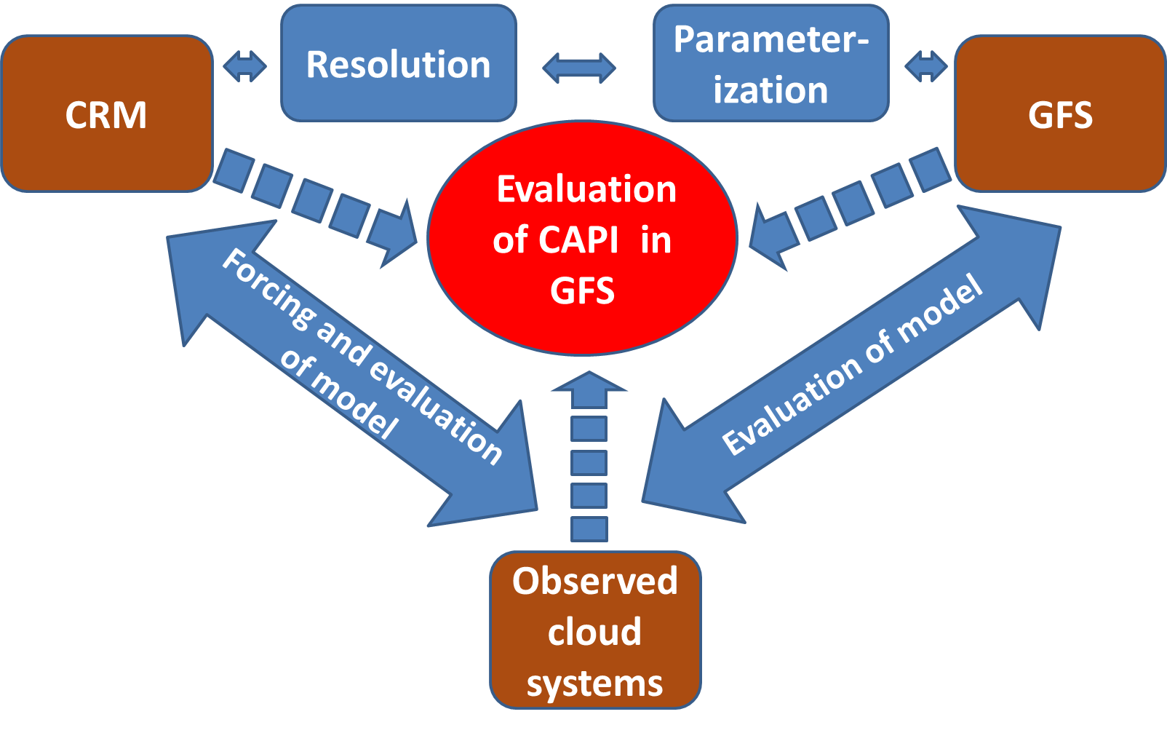
Evaluating the Impact of Cloud-Aerosol-Precipitation
Interaction Schemes on Rainfall Forecast in the NGGPS
PI: Zhanqing Li, University of Maryland
Deliverables
Identified systematic errors in the NWP due to unaccounted aerosol effects using satellite and ground-based data;
Evaluation results of physical schemes associated with accounting for the aerosol and cloud effects;
Improved understanding of the performance of new physical schemes with the aid of a cloud resolving model.
Goal:
Improve cloud and rain forecasting by accounting for aerosol effects following data analysis, cloud resolving modeling (CRM) and single column modeling (SCM)

Slide 18
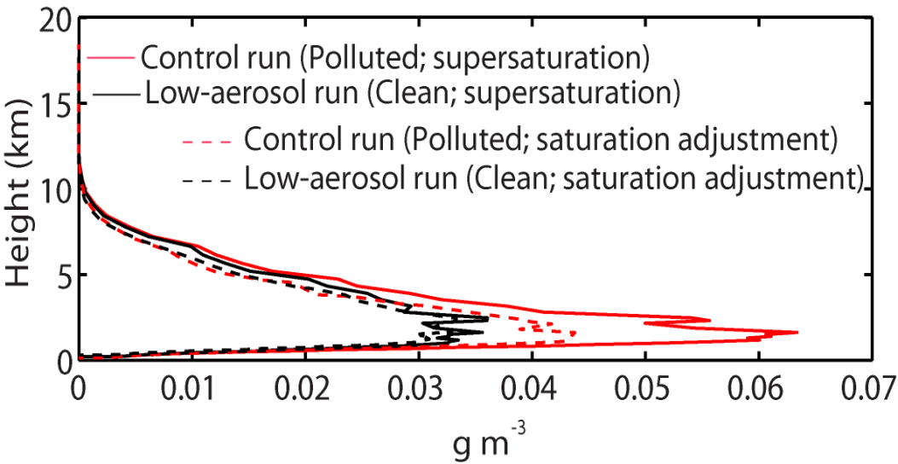
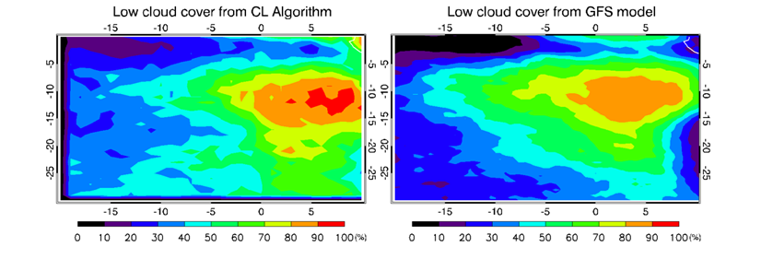
Improve Cloud & Aerosol Parameterizations in the NGGPS
Identifying Model Deficiencies and Finding Solutions
using Observations and Model Simulations:
Connection to NGGPS
1. Model test on microphysics parameterizations as a source of the GFS error using cloud resolving model
2. Evaluation of the GFS model in cloud properties
and meteorological variables using observations
Objective: Improvement of cloud cover representation in the current model that is susceptible to the influences of aerosol.
We find systematic biases found in different regimes influenced by different types of aerosol. It is essential to identify the sources of errors in terms of various aerosol effects that influencing cloud by modulating radiation and cloud microphysics.
Fig 2. Monthly mean low cloud covers in the the Namibian region from satellite (left) and the GFS model (right) in July 2014. The region is susceptible to smoke.
Publications:
Jiang, M., Z. Li, B. Wan, and M. Cribb, 2016: Impact of aerosols on precipitation from deep convective clouds, J. Geophys. Res. – Atmos., in revision.
Lee, S.-S., Z. Li, Mok, ­Interactions between aerosol absorption, thermodynamics, dynamics and microphysics and their impacts on clouds and precipitation in a multiple-cloud system, J. Geophy. Res., revised.
Figure 1. Vertical distributions of cloud-liquid content (CLC)
for a simulated case of deep convective clouds
The repeated standard CRM simulations with saturation
adjustment (dashed lines) show much smaller sensitivity
of CLC to aerosol than the standard simulations with
supersaturation prediction (solid lines)
2. Future Tasks/Deliveries
Testing on rain collection and sedimentation processes
Evaluation of the model resolutions as another source
of the GFS error in implementing new microphysics schemes
Zhanqing Li (Univ. of MD): Evaluating the Impact of Cloud-Aerosol-Precipitation Interaction (CAPI) Schemes on Rainfall Forecast in the NGGPS
Notes:
Here, I show results about how saturation adjustment in Hugh Morrison scheme, which is now being implemented to the GFS, affects cloud sensitivity to aerosol as compared to the sensitivity with sophisticated microphysics. This is a first step to identify key impacts of the parameterization of important microphysical processes on aerosol-cloud interactions. Next step is to test other important microphysical processes such as collection and sedimentation processes. Through the next step, we can get a more comprehensive understanding of the impacts of microphysical parameterization on the GFS errors in the simulation of aerosol-cloud interactions.
It is essential to evaluate the baseline GFS model before any new scheme implemented. Cloud properties produced by GFS have been compared with satellite observations as shown in the figure. The next step is to evaluate the model using ground observations from ARM sites to test the model performance in cloud and related process which affect rainfall, and we hope to understand causes of discrepancies in simulating clouds and their interactions with aerosol.

Slide 19
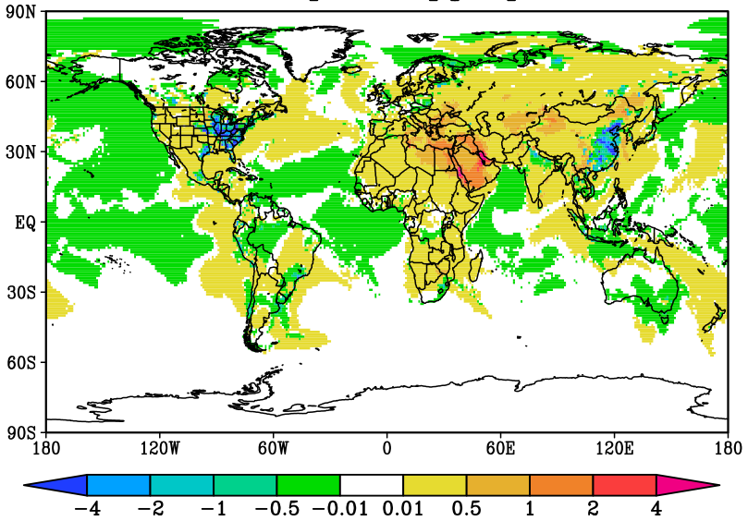
Using advanced photochemical and aerosol modules to verify the applicability of GOCART aerosol modules within global weather prediction mode
Georg A. Grell (NOAA/ESRL/GSD) and Stuart A. McKeen (NOAA/ESRL/CSD)
A complex gas-phase chemistry packages was developed and implemented into a global modeling system. This includes implementation of wet and dry deposition, aqueous phase chemistry, biogenic emissions, biomass burning, dust and sea-salt (package with medium sophistication as in the ECMWF system)
As an initial step to determine the degree of complexity necessary to estimate the impact of aerosols on numerical weather prediction skill, the impact on the GOCART aerosol modules with a very simple chemistry package is evaluated
Difference of sulfate aerosols, resulting from 2 different 7 days simulations. One using GOCART simple chemistry (L0) and another sophisticated chemistry package (L1). Displayed is L1 – L0. Differences are caused from much more complex treatment of aerosol chemistry in L1. L0 is using climatological background values for OH, H₂O₂, and NO₃ while for L1 they are calculated at every timestep. Units are ppm*1.e-3.
Relative differences are ~40% in the eastern US and in the Beijing region.
Current and future work is focused on testing a much more complex modal aerosol package that includes a Secondary Organic Aerosol module. We will also look at the impact on global weather prediction

Slide 20
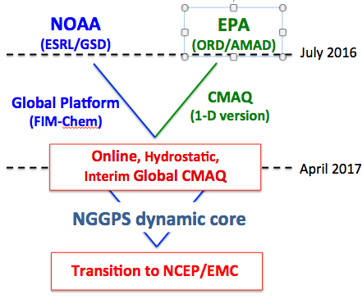
Developing a unified online air quality forecasting system based on CMAQ and NGGPS
Georg Grell (NOAA/ESRL/GSD), Stuart Mc Keen (NOAA/ESRL/CSD), Jon Pleim (EPA), Rohit Mathur (EPA)
This is a collaborative effort between NOAA and EPA to create a new online state-of-the-art air quality forecast system based on the currently operationally used CMAQ modules and the new NGGPS dynamic core. EPA will provide their efforts in kind.
The resulting modeling system can also be used for weather forecasting or to provide more accurate aerosols concentrations for numerical weather prediction models
Deliverables include an evaluated scale independent air quality forecasting system
Provide a candidate online air quality forecasting system.
Integrate the development and implementation of weather and air quality prediction model components within NGGPS.
*Co-funded by USWRP and NGGPS

Slide 21
Coordination and interactions
  Coordination with other Science Working Groups (SWG) and Teams
  Aerosol-radiation processes with Radiation SWG
  Aerosol-microphysics processes for condensation, nucleation, etc. with Microphysics SWG
  Aerosol impact on assimilation of satellite radiances with DA team
  Coordination with other programs (CPO, USWRP, R2X)

Slide 22
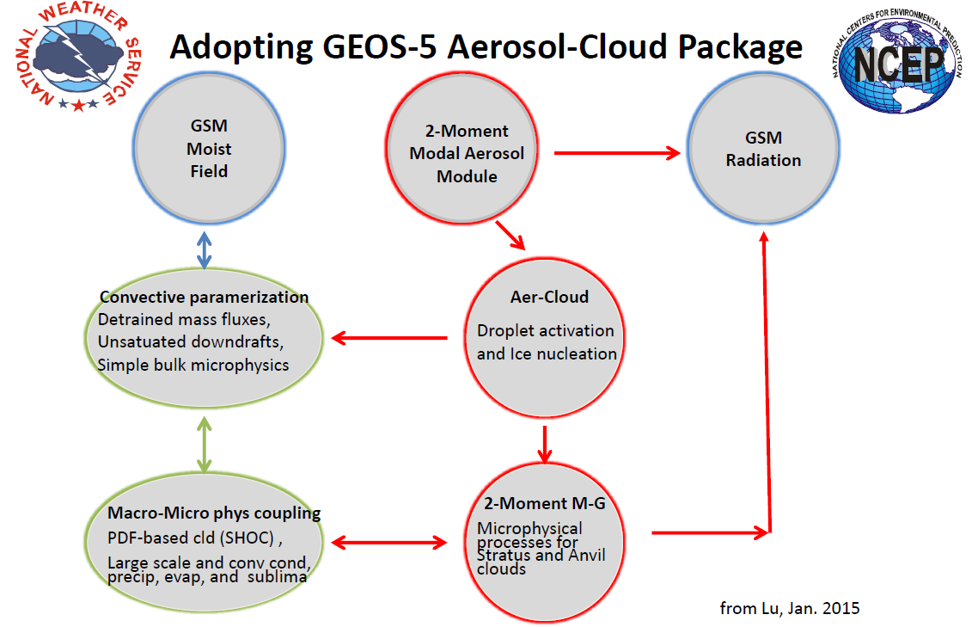
Adopting GEOS-5
Aerosol-Cloud Package

Slide 23
Aerosol-Cloud-Radiation Processes
Three MAPP-CTB projects
1) PBL-Convection-Clouds (Steven Krueger, University of Utah & Shrinivas Moorthi NCEP/EMC (2014-2017)
  Based on Assumed PDF method with a Simplified High-Order Closure (SHOC) scheme to bring in advanced TKE-based PBL scheme, and the Chikira and Sugiyama (C-S) cumulus convection scheme for deep convection.
2) Cloud-microphysics Interacts with Aerosols and Radiation (Sarah Lu, SUNYA and Yu-Tai Hou NCEP/EMC (2014-2017) co-funded by NGGPS
  Adapting the Aerosol-Cloud-Microphysics component from NASA GEOS-5 to the NEMS/GSM-GFS. The aerosols part contains an upgraded GOCART bulk aerosol scheme and the Modal Aerosol Module (MAM) aerosol scheme. The cloud-microphysics part is a modified Morrison-Gettleman's double-moment scheme, which is being included through an NGGPS-funded physics effort (PI Moorthi).
3) PBL-Convection-Clouds (Chris Bretherton, University of Washington and Jongil Han NCEP/EMC (2014-2017)
  Follow-on the project co-lead by Hualu Pan in 2010-2013. Focus on development of TKE-based Eddy-Diffusivity Mass-Flux (EDMF) scheme. In its extended development stage, an upgrade of cloud-microphysics based on WSM6 scheme is also tested.
·
·

Slide 24
Aerosol and Atmospheric Composition
FY 16 Team Plan Short-term Priorities
Development of aerosol verification package to include the following evaluation datasets – initial input provided for verification requirements document
  Composition (from surface, field measurements)
  MODIS, VIIRS , AHI, ABI AOD – EMC receiving VIIRS AOD data
  Particle size distribution (from AERONET measurements)
  CALIPSO (expedited product plume height)
  Deposition (for coupled system verification)
Comparison of real-time biomass burning emission approaches: GBBEPx (NESDIS), QFED (GSFC), and GFAS (ECMWF) -GBBEPx vs QFED comparison in progress for NGAC v2
  Gaseous (ozone) chemistry for stratosphere and troposphere (use 3d production and loss rates with diurnal cycle from retrospective CTM runs) – R2X proposal

Slide 25
Aerosol and Atmospheric Composition
FY 16 Team Plan Long-term Priorities
Determine interface for inclusion of aerosol and atmospheric composition components into NGGPS
Intercomparison of aerosol model approaches for aerosol component (GOCART, MAM)
Gaseous (ozone) chemistry for stratosphere and troposphere (coordination with USWRP and R2X)
  consider available approaches of varying complexity (climatological production and loss rates, reduced mechanism, full chemistry) e.g RAQMS-reduced, AM3, MOZART, RAQMS, GMI
  recommend several approaches as potential candidates for evaluation
  evaluate impact on the meteorological forecast skill

Slide 26
Aerosol and Atmospheric Composition
FY 16 Team Plan Long-term Priorities
Assimilation of AOD data from additional satellites (combined MODIS/VIIRS, AHI, ABI)
Assimilation of ozone/precursor data from OMI, OMPS (nadir and limb), CRIS, IASI and additional satellite data
Plume injection height for fire emissions (leverage FIREX, JPSS fire and smoke initiative, NASA NRL efforts; validation datasets CALIPSO, MISR)
Forecast impact assessment and coordination with Physics and Data Assimilation Teams:
  Data assimilation of meteorological variables
  Aerosol and ozone radiative impacts
  Aerosol-microphysics interactions

Slide 27
NGGPS Aerosol and Atmospheric Composition Three Main Points
One Major Accomplishment:
  Included Modal Aerosol Model (MAM-7) and two moment Morrison and Gettleman microphysics into NEMS GSM and tested separately
One priority focus effort for FY16:
  Include aerosol radiative effects in GSM
One most important issue or coordination need:
  Close coordination with physics (radiation and microphysics),
  data assimilation, dynamical core (tracer transport: conservation, computing needs) and verification

Slide 28
Summary
Model development to transition from research to NWS operations improved (more complete, accurate and efficient) representation of atmospheric aerosols and atmospheric composition
Include impacts of predicted aerosols and atmospheric composition on radiation, microphysics and data assimilation
Community involvement (model development team, development efforts, models). Development includes efforts by universities and NOAA labs in coordination with other NOAA programs: CPO, USWRP, R2X)
Parallel development, testing and evaluation as NGGPS is built

Slide 29
Questions?
NGGPS Website:
http://www.nws.noaa.gov/ost/nggps

Slide 30
The Modal Aerosol Module (MAM)
A modal aerosol module (MAM, Liu et al., 2012) has been developed for the Community Atmosphere Model version 5 (CAM5), the atmospheric component of the Community Earth System Model version 1 (CESM1).
MAM is capable of simulating the aerosol size distribution and both internal and external mixing between aerosol components, treating numerous complicated aerosol processes and aerosol physical, chemical and optical properties in a physically-based manner.
Aerosol components
  Sulfate
  Ammonium
  Black carbon
  Dust
  Sea salt
  Primary organic
  Secondary organic
Aerosol modes
  Aitken
  Accumulation
  Primary carbon
  Fine sea-salt
  Fine dust
  Coarse sea salt
  Coarse dust
Aerosol microphysics
  Nucleation (H2SO4-NH3-H2O and BL nucleation)
  Coagulation (intra- and intermodal of AIT, ACC, PCM)
  Condensation(H2SO4, NH3 and SOA(g))
  Gas-aerosol exchange
A. Darmenov (GSFC)

Slide 31
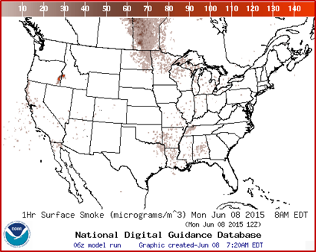
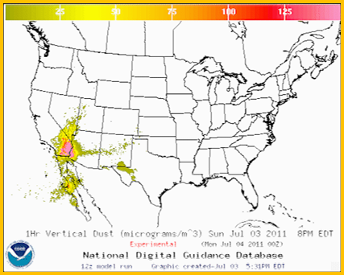
NOAA operational predictions of atmospheric dispersion
Routine predictions:
Smoke predictions nationwide http://airquality.weather.gov/
Dust predictions over contiguous 48 states (CONUS) http://airquality.weather.gov/
CTBTO on-demand backtracking capability
Incident support:
Volcanic ash
Radiological contamination
Chemical releases
All the above dispersion applications rely on HYSPLIT model.
Verification of dust and smoke predictions uses satellite retrievals of dust and smoke.

Slide 32
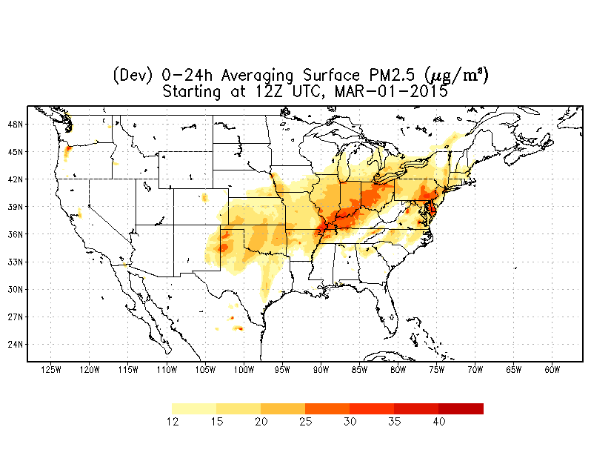
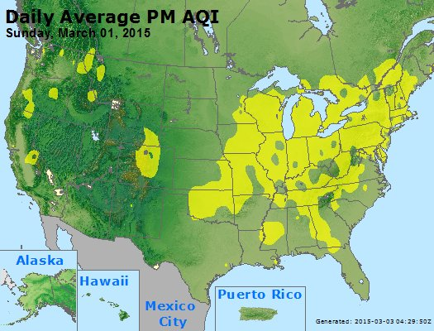
National Air Quality Forecast Capability: PM2.5 Predictions
Development of fine particulate matter (PM2.5) predictions
  Community Multiscale Air Quality (CMAQ) driven by North American Mesoscale Model (NAM)
  Emissions based on the National Emissions Inventory (NEI), versions 2005 and 2011
  Real time dust and wildfire smoke sources
  Testing of lateral boundary conditions from the global NEMS GFS Aerosol Component (NGAC)
  Exhibits seasonal biases; bias correction procedure in testing
  Verification uses surface PM2.5 observations
Model prediction
Map constructed from observations

